Slide 1



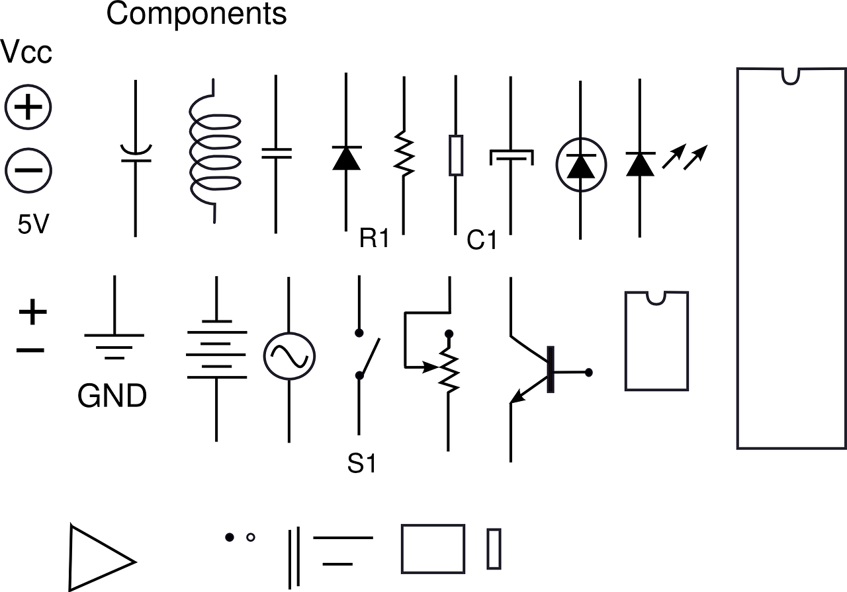
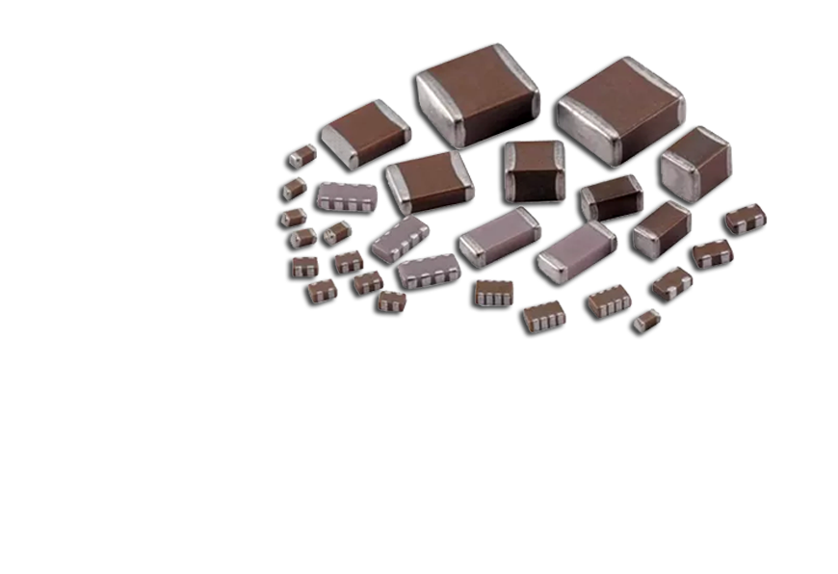

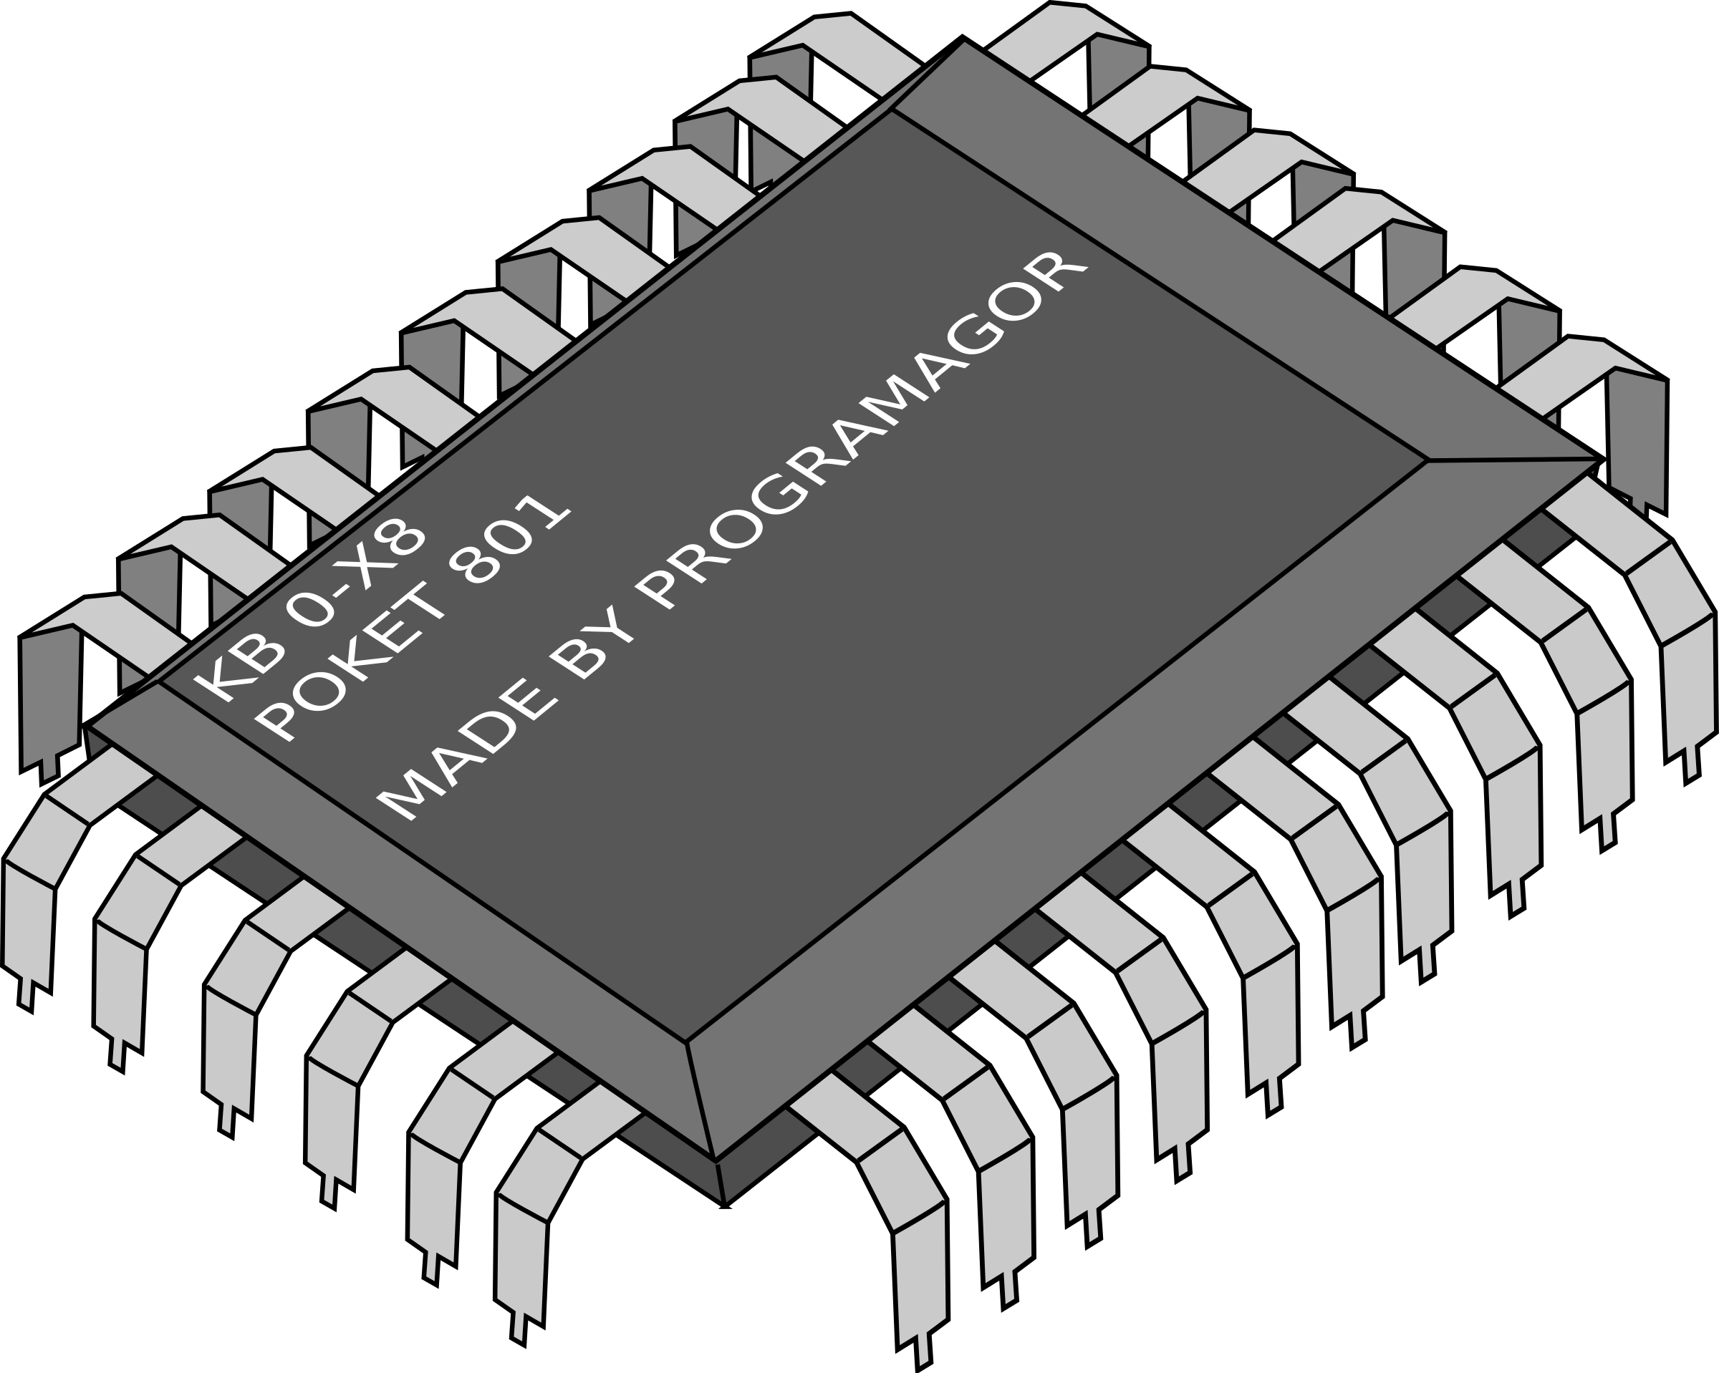
Electronic Device Component
HO CHI MINH CITY UNIVERSITY OF TECHNOLOGY
COMPUTER ENGINEERING

Slide 2


